Slide 1


Slide 2

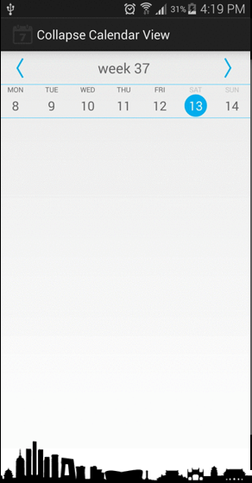
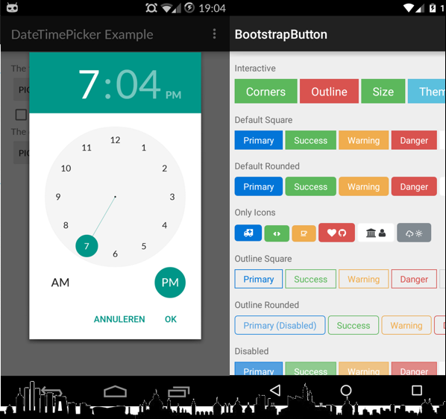
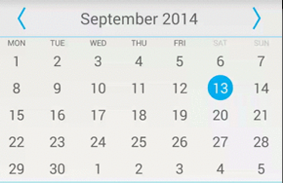

Slide 3


Slide 4


Slide 5


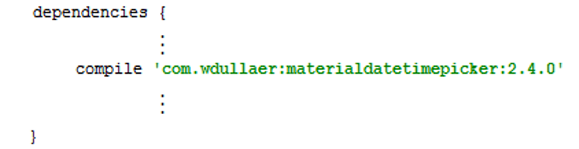
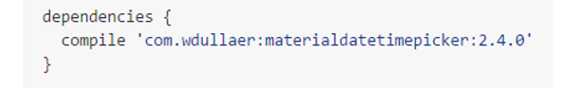

Slide 6


Slide 7
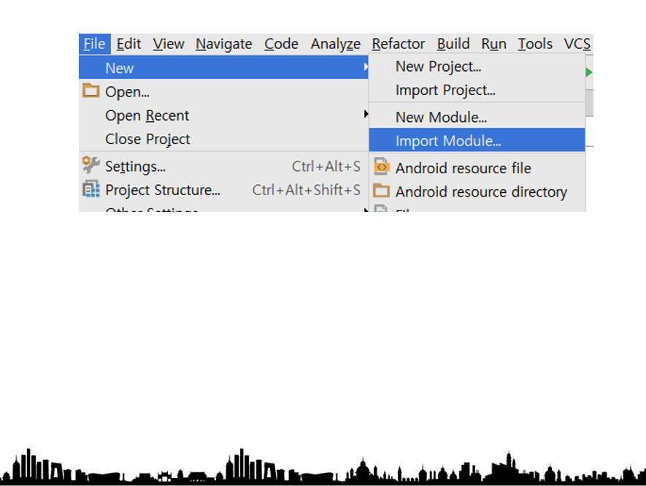
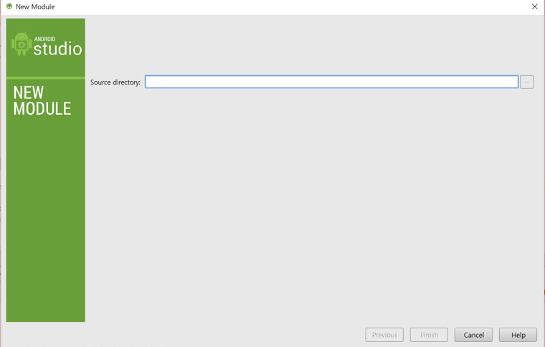
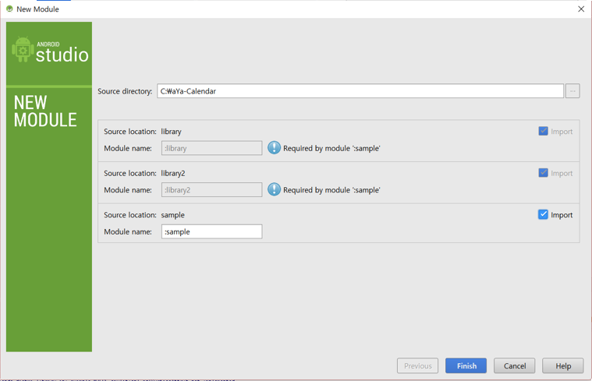
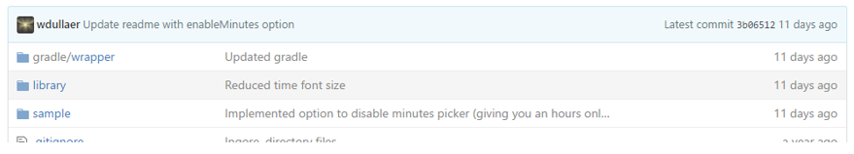

Slide 8


Slide 9


Slide 10
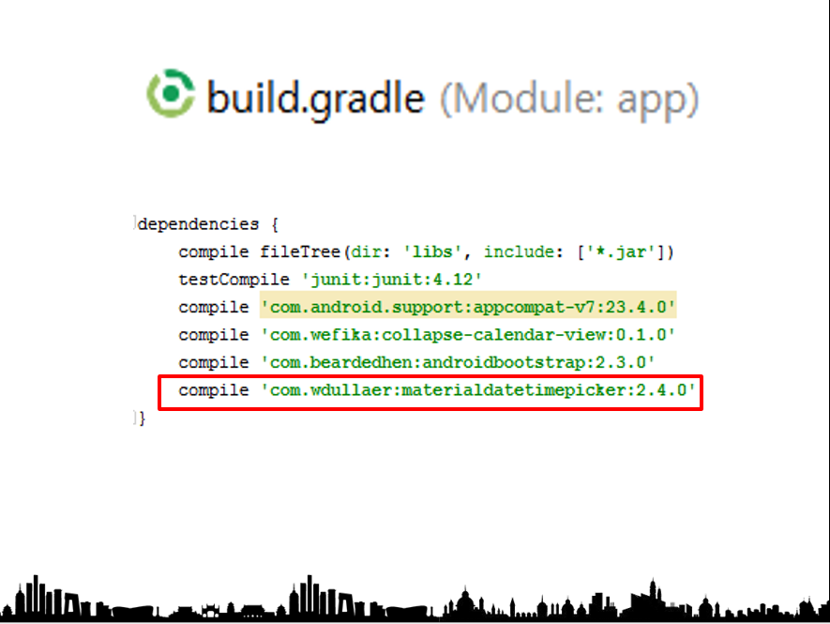

Slide 11
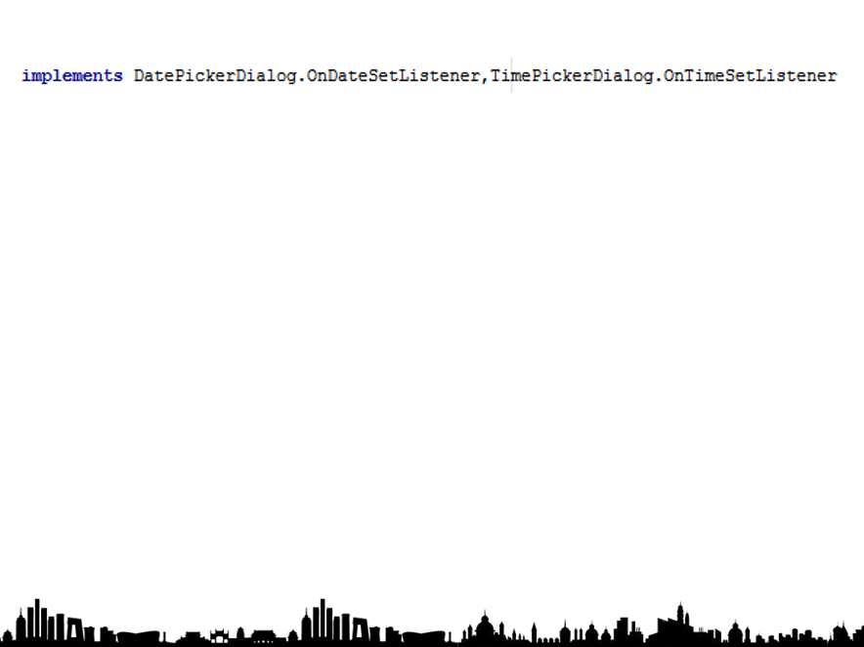
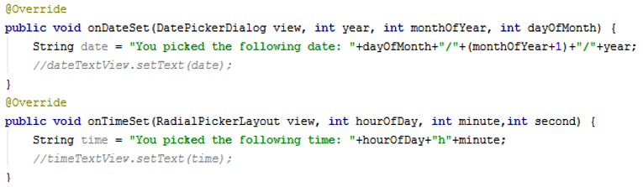

Slide 12
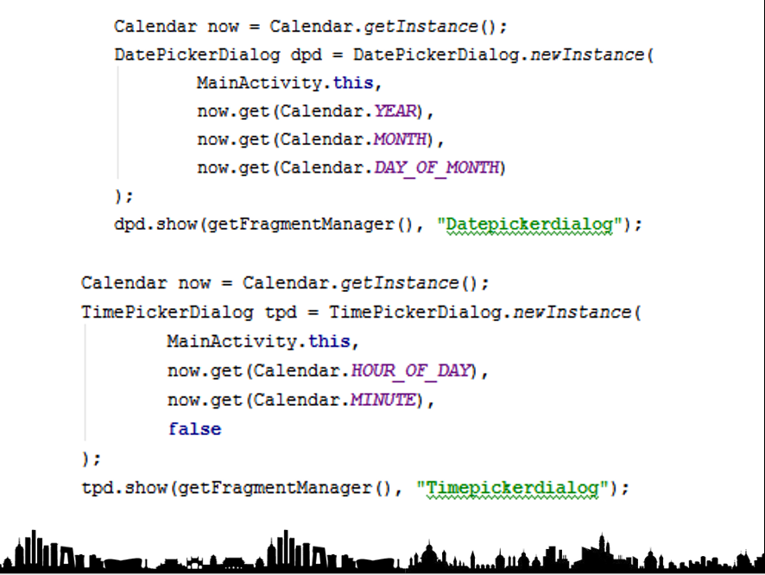

Slide 13
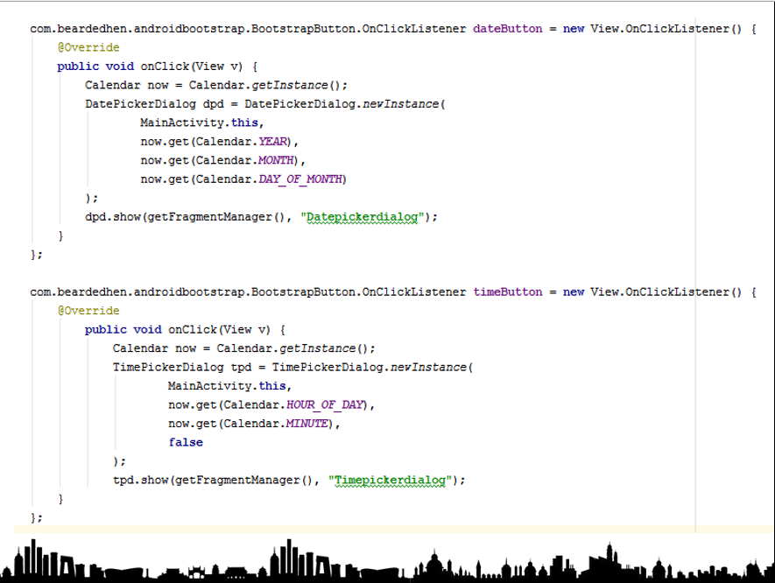

Slide 14


Slide 15
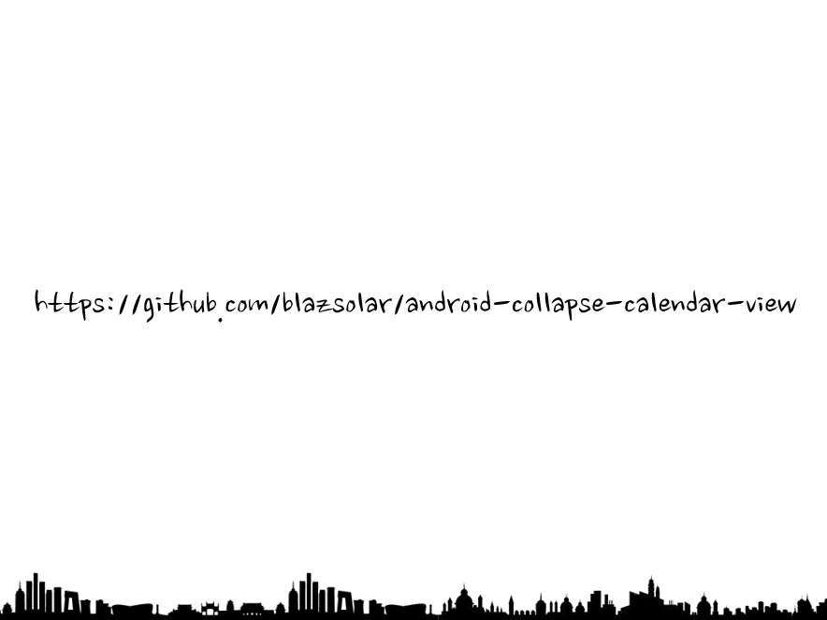

Slide 16
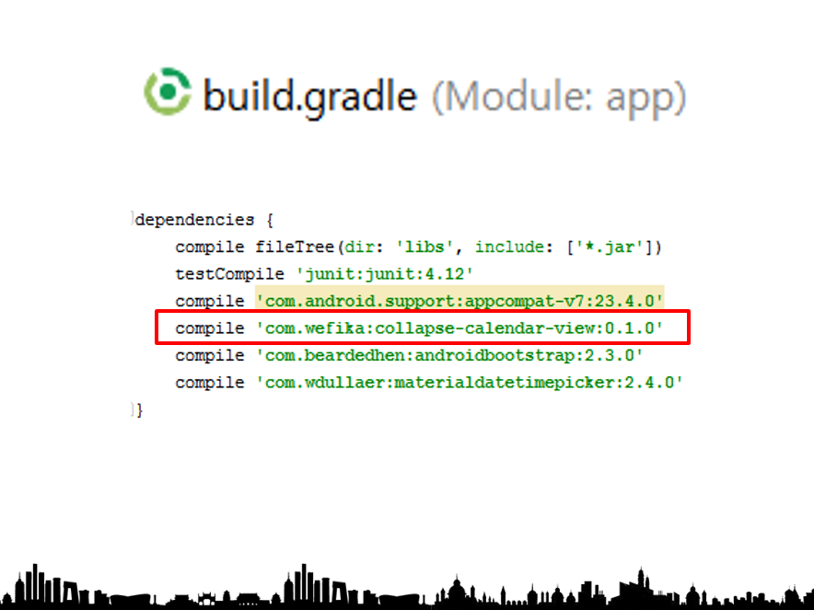

Slide 17
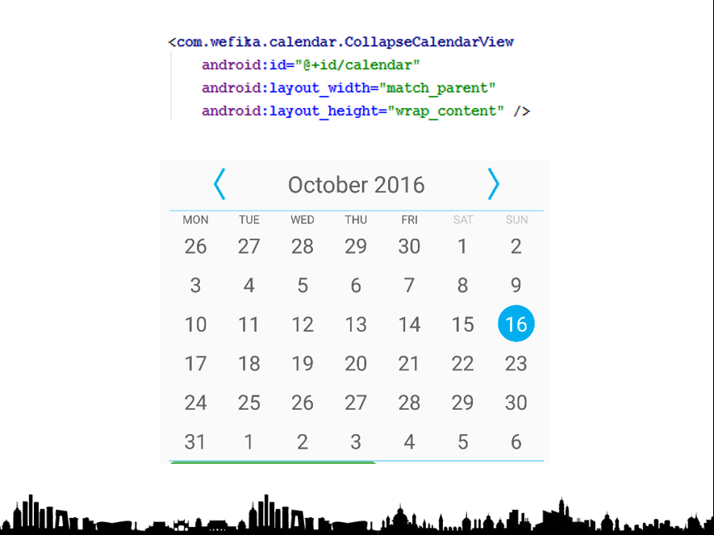

Slide 18
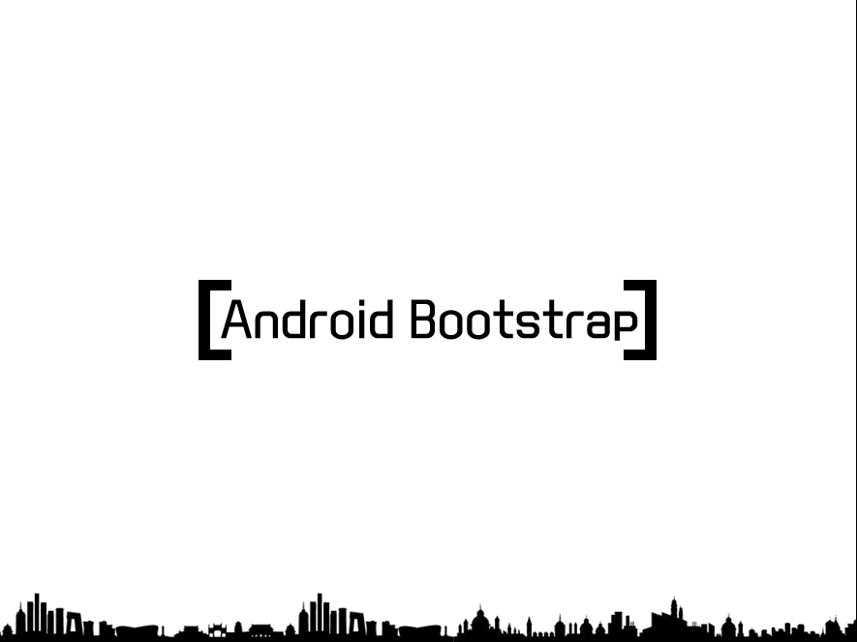

Slide 19
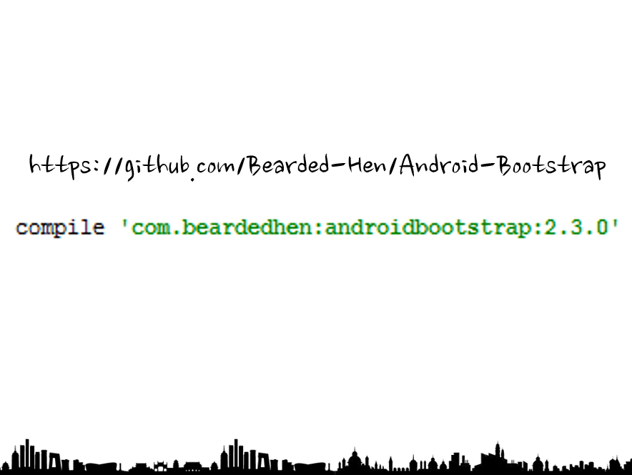

Slide 20

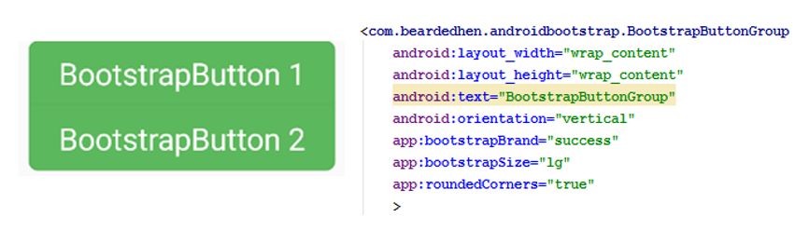
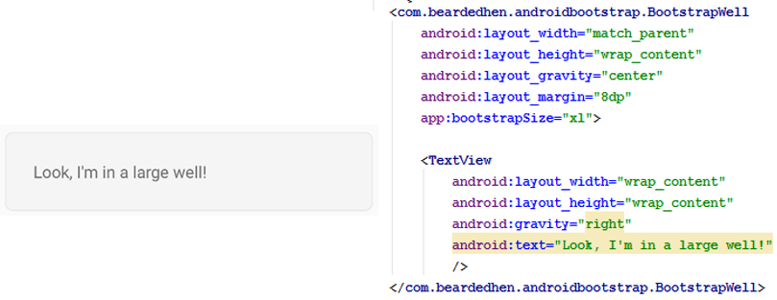

Slide 21
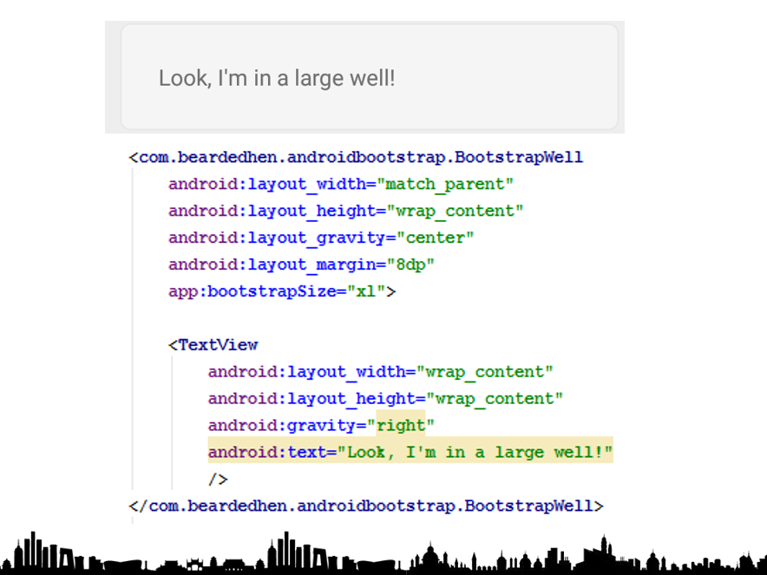

Slide 22
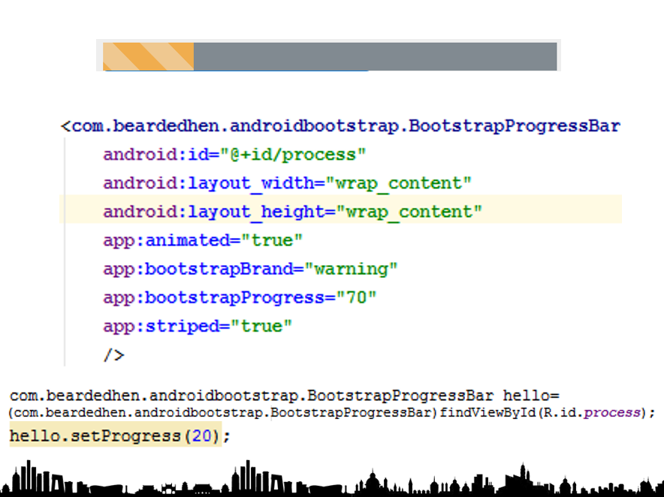

Slide 23
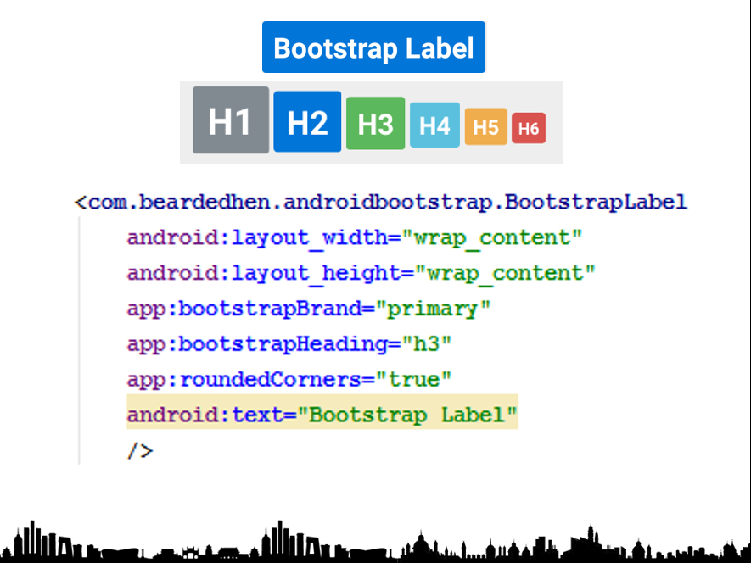

Slide 24
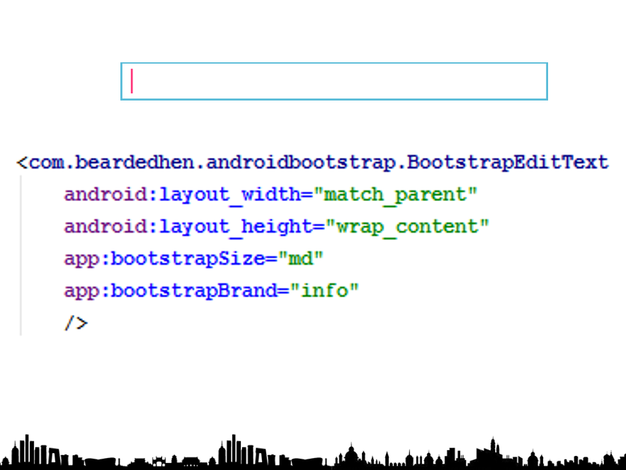

Slide 25
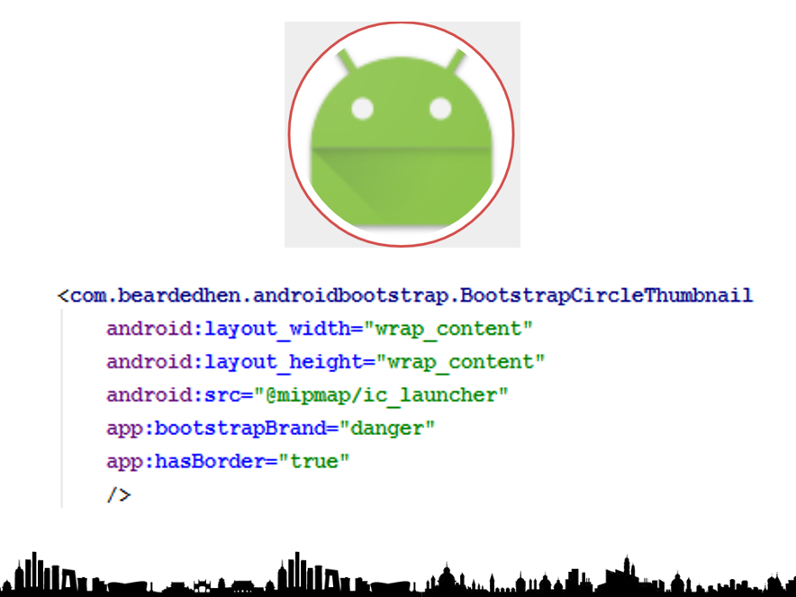

Slide 26


Slide 27
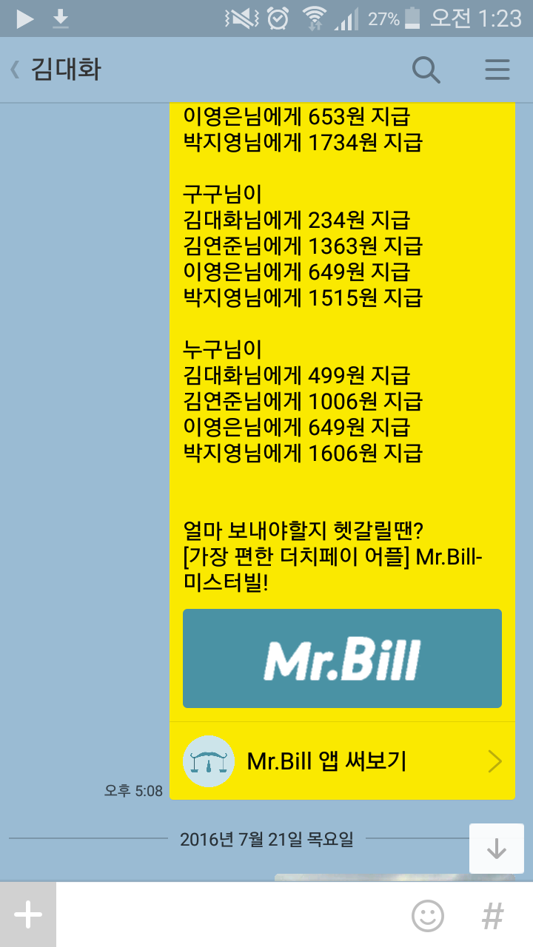
What is API?

Slide 28
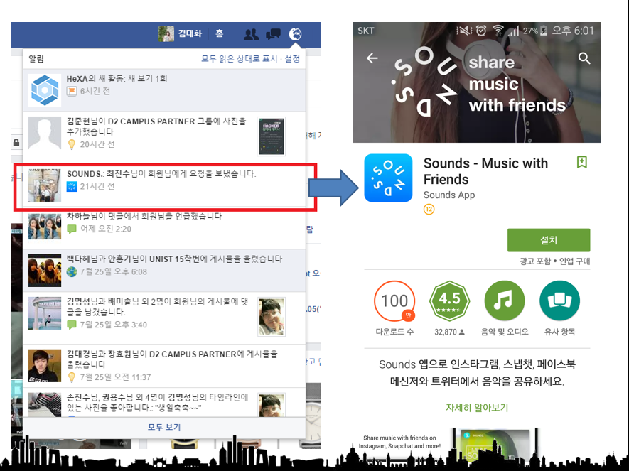

Slide 29


Slide 30
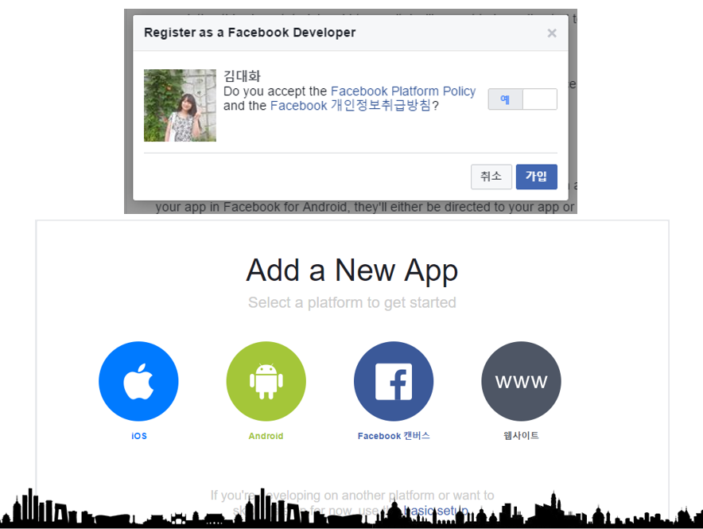

Slide 31
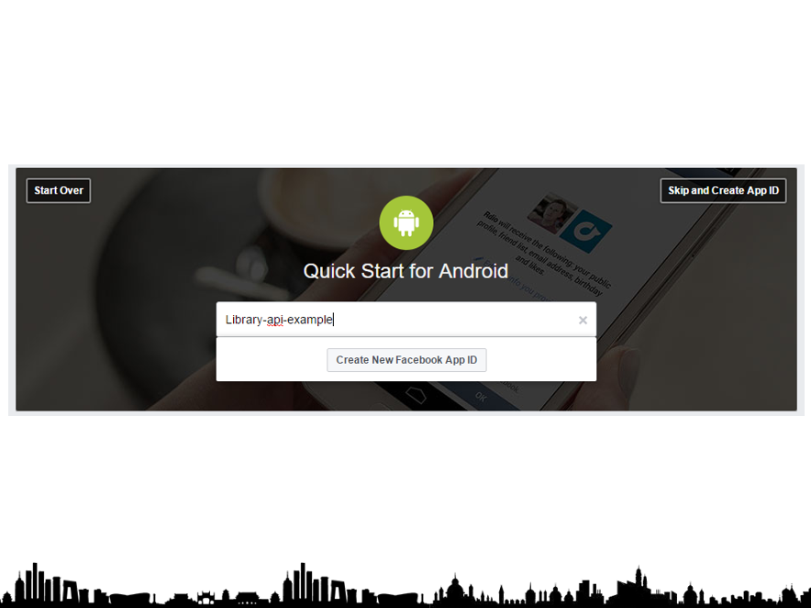

Slide 32
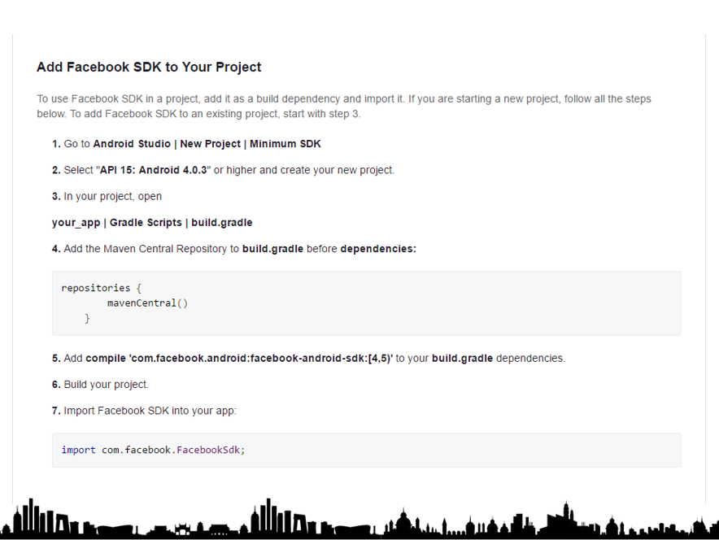

Slide 33
Creativity

Slide 34
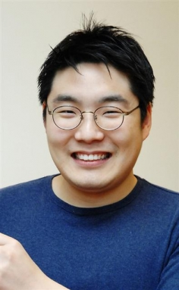
UX inventor
UX;
User eXperience

Slide 35
UX inventor
Make good interface
Make human and computer interaction

Slide 36
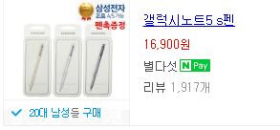
Magnetic touch pen
45,162 cym

Slide 37
Magnetic touch pen
Smart phone
Magnet : 500won (1338cym)
Smart phone
Magnetic sensor

Slide 38


Magnetic touch pen
Smart phone
Smart phone

Slide 39
Magnetic touch pen
Smart phone
Outer Range of screen
Smart phone

Slide 40
Emotion phone case

Slide 41
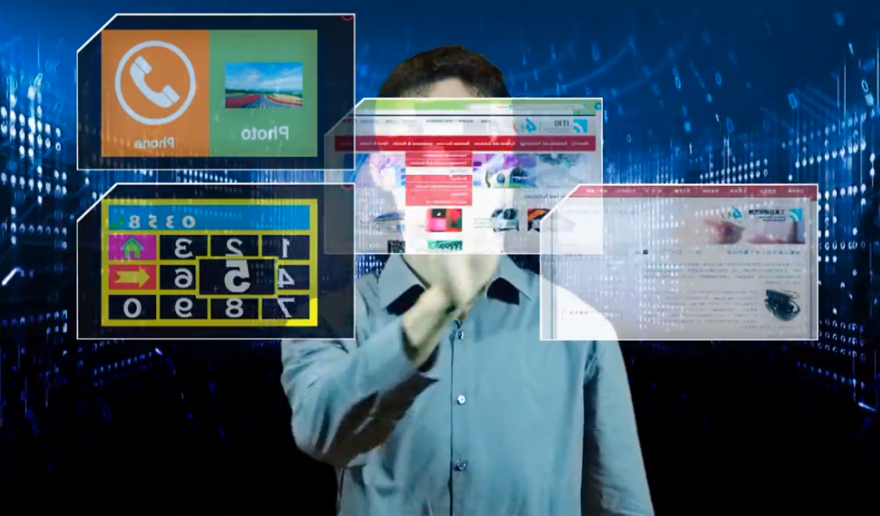
Air touch screen

Slide 42
Air touch screen
Touched
State

Slide 43
Vibration camera(Vibration haptic)
Smart phone
Smart phone

Slide 44
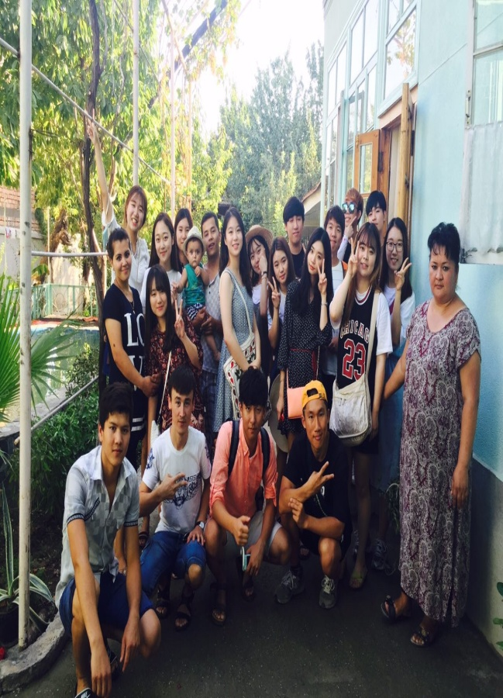
Vibration camera(Vibration haptic)
Smart phone

Slide 45
Vibration camera(Vibration haptic)
Smart phone
Smart phone
RRrrrrr….

Slide 46
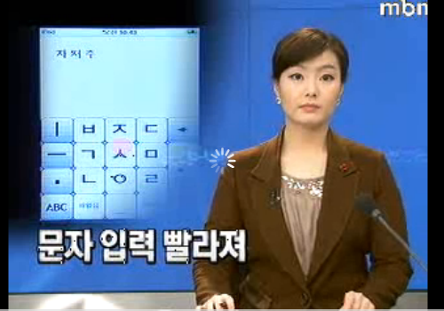
Virtual finger
500,000,000won
1,338,449,080cym
Notes:
When you text message, you can put your text using only one finger.
You can do multi-touch using only one finger.
He got 0.5 billion from ㈜빅트로닉스 who is manufacturing company.

Slide 47
Virtual finger
ㅅ
ㅏ
ㅣ
ㅂ
ㅈ
ㄷ
←
ㅡ
ㄱ
ㅅ
ㅁ
●
ㄴ
ㅇ
ㄹ
ABC
쌍자음

Slide 48
Virtual finger
ㅅ
ㅜ
ㅣ
ㅂ
ㅈ
ㄷ
←
ㅡ
ㄱ
ㅅ
ㅁ
●
ㄴ
ㅇ
ㄹ
ABC
쌍자음

Slide 49
Virtual finger
ㅅ
ㅠ
ㅣ
ㅂ
ㅈ
ㄷ
←
ㅡ
ㄱ
ㅅ
ㅁ
●
ㄴ
ㅇ
ㄹ
ABC
쌍자음

Slide 50
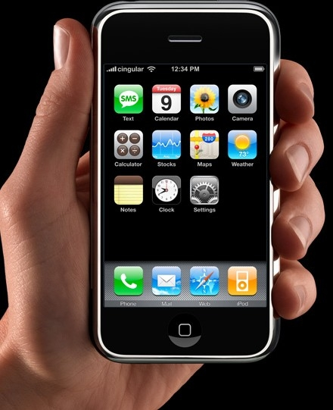
Solving the problems faster…?
So many information by inventing of smart phone

Slide 51
Solving the problems faster
vs
Defining the problem
Defining the problem
Only human can do

Slide 52
